Slide 1
Youth Career Development Competency (YCDC): Factor Structure and Scale Validation in Hong Kong Youth Aged 13-18
Prof. Steven Ngai Sek-yum
Department of Social Work,
The Chinese University of Hong Kong;
Director (Community, PI), CLAP@JC
Prof. Chau-kiu Cheung
Department of Social and Behavioural Sciences,
City University of Hong Kong;
Co-Director (Research, Community, Co-PI), CLAP@JC
Dr. Lin Wang
Department of Social Work,
The Chinese University of Hong Kong;
Postdoctoral Fellow, CLAP@JC
Co-created by:
Created and Funded by:

Slide 2
Introduction: Youth Career Development Competency (YCDC)
School-to-work transition for young people
Economic globalization and advanced technology: Lead to an unpredictable job environment characterized by keen competition and job transformations in the labor market
(Wells, 2018)
Multiple pathways in the transformed labor market complicates the entire process of school-to-work transitions, making it more challenging for young people to make career decisions
(European Centre for the Development of Vocational Training, 2014)
Youth Career
Development Competency (YCDC)
YCDC is crucial for youth to keep up with an increasingly dynamic and changing work environment, to adjust to more complex careers
(Akkermans et al., 2013; Segers & Inceoglu, 2012;
Vuori et al., 2012)
Research on the development and validation of YCDC instruments for youth 13-18 years of age is scarce
Challenges faced by young people
experiencing school-to-work transition
Unsatisfactory employment
Poor work conditions
High levels of career discontinuity and underemployment
Lack of social mobility
Social, emotional, and behavioral problems (e.g., social withdrawal, low self-confidence, hopelessness, passivity, and criminal behavior)
(European Commission, 2012; Koivisto et al., 2007; Koivisto et al., 2010; Huegaerts et al., 2018; Ngai et al., 2014; Wong, 2012)
Aim
Develop a holistic measurement instrument: Effectively enables young people to identify their career development competency, approach labor market entry, and career progression in an informed and confident manner
Page 2
Notes:
This page is for Slide mainly with text

Slide 3
Literature Review: Past Studies and Research Gap
Research Gap
Past studies mainly covering three aspects of YCDC
Self-understanding
Career and pathway exploration
Career planning and management
(Akkermans et al., 2013; CLAP for Youth@JC, 2017; Kuijpers et al., 2006)
Overlook engagement aspect of YCDC
Career-related and Psychosocial Outcomes among Youth in Transitional Status
YCDC may have positive relationships with career-related outcomes: career adaptability; career outcome expectancy
YCDC may enhance one’s psychosocial outcomes: social integration; civic engagement; social contribution
(Akkermans et al., 2018; Diegelman & Subich, 2001; Akkermans et al., 2018; Bakker & Demerouti, 2017; Savickas & Porfeli, 2012; Siddique, 1981; Ma et al., 2016; Cheung & Liu, 2017; Coulter-Kern et al., 2013)
Concurrent validity of the YCDC scales is lacking
Subgroup Consistency of the YCDC Scale
Previous research on YCDC scales lacked an investigation of subgroup consistency by gender and the years of residence in Hong Kong
(Bocciardi et al., 2017; Rohlfing et al., 2012; Zacher, 2014)
Subgroup consistency validation of the YCDC scales is lacking
Page 3
Notes:
This page is for Slide mainly with text

Slide 4
Present Research: YCDC Components
Engagement
the ability of young people to get involved in new experiences, extend their connection with others and the community, and maintain interest in participating in career and life planning activities.
Self-understanding
the ability of young people to comprehend their hopes and dreams about work and life, engage in self-reflection and self-enhancement activities, and connect self-knowledge with pathway alternatives.
Career and pathway exploration
the ability to explore multiple pathways and multiple forms of work and career, compare pathway alternatives and prioritize them, as well as set career and life goals.
Career planning and management
the ability to seek support and opportunities, overcome obstacles, and manage career transition and development.
(CLAP for Youth@JC, 2017)
Page 4
Notes:
This page is for Slide mainly with text

Slide 5
Influence of Hong Kong Chinese Context & the relationship
between Career-related and Psychosocial Outcomes
among Youth on YCDC components
1. Hong Kong Chinese Context
Unique sociocultural characteristics
Collectivistic culture
and family orientation
2. Career-related and
Psychosocial Outcomes among Youth
Positive relationships between
YCDC & career-related outcomes
Positive relationships between
YCDC & psychosocial outcomes
The influence of the pandemic and the high unemployment rate
Existing school support related to YCDC: Information regarding further study opportunities
Further education as the most promising choice for their children
(Pavlova et al., 2017b)
Social expectations and obligations are given priority over individual preferences
(Cheung & Arnold, 2014; Leung, 2002)
Exert an impact on young people’s educational and occupational aspirations, which further influence how young people make decisions about education and career pathways
(Hui et al., 2018)
Career adaptability
(Akkermans et al., 2018)
Career outcome expectancy
(Diegelman & Subich, 2001)
Social integration
(Savickas & Porfeli, 2012;
Siddique, 1981)
Civic engagement
(Ma et al., 2016)
Social contribution
(Cheung & Liu, 2017)
Page 5
Notes:
This page is for Slide mainly with text

Slide 6
Present Research Aims to Provide a Holistic Instrument
to Measure YCDC among Young People in HK
1.
Measuring four potential components
2.
Concurrent Validity of YCDC
3.
Subgroup Consistency of YCDC
Correlations between YCDC and career-related as well as psychosocial outcomes
Gender: Male vs. Female
Self-understanding
Career and pathway exploration
Career planning and management
Years of residence in Hong Kong: ≤ 17 years (shorter) vs. > 17 years (longer)
Engagement
median as a cut-off (DeCoster et al., 2011)
Page 6
Notes:
This page is for Slide mainly with text

Slide 7
Research Method
503 participants aged 13-18 (M=16.79, SD=1.18)
Complete two parts of questionnaire
17 items measuring YCDC Components:
Engagement
Self-understanding
Career and pathway exploration
Career planning and management
Concurrent validity:
Check correlation of these variables
Career-related and psychosocial outcomes:
Career adaptability
Career outcome expectancy
Civic engagement
Social contribution
Social integration
1. Exploratory factor analysis (EFA)
2. Confirmatory factor analysis (CFA)
3. Subgroup consistency validation
4. Internal consistency reliability
5. Concurrent validity
Model fit indices:
Comparative fit index (CFI)
Tucker-Lewis Index (TLI)
Root mean square error of approximation (RMSEA)
The standardized root mean square residual (SRMR)
Two respective pairs of subgroups:
Gender
Years of residence in Hong Kong
Cronbach’s alpha coefficients:
With 0.70 as the cutoff for acceptable reliability
(Pallant, 2020)
Pearson’s correlation coefficients:
YCDC scale & the measures of career-related and psychosocial outcomes
Page 7
Notes:
This page is for Slide mainly with text

Slide 8
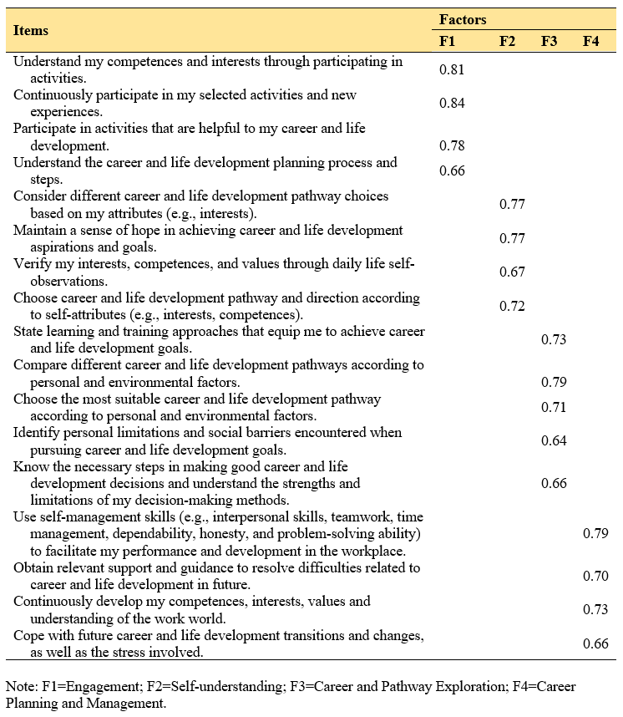
Results: Exploratory Factor Analysis (Table 1)
Table 1: Rotated factor loadings matrix from EFA (n = 249)
% of the total variance
21.22
20.47
19.08
18.94
Suitable for PCA: The KMO coefficient was 0.96 and the Chi-square from the Bartlett test was 3867.02 (p<0.001) for the YCDC scale
Factor loadings of the terms included in engagement, self-understanding, career and pathway exploration, career planning and management were all greater than 0.50 (p<0.001)
Page 8
Notes:
This page is for Slide mainly with text

Slide 9
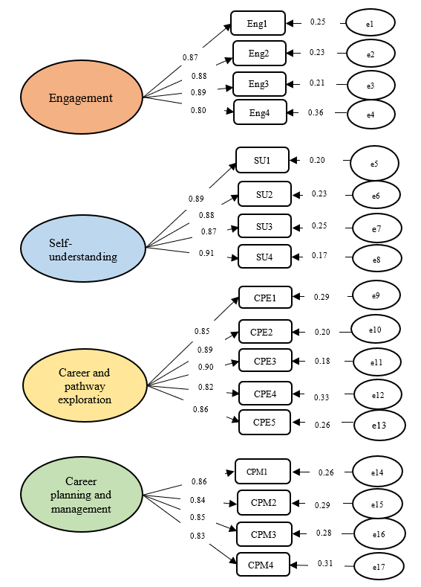
Results: Confirmatory Factor Analysis (Figure 1)
Figure 1: CFA factor structure and the standardized factor loadings (n=254)
The factor loadings ranged from 0.83 to 0.91 for engagement; from 0.80 to 0.88 for self-understand; from 0.81 to 0.89 for career and pathway exploration; and from 0.78 to 0.84 for career planning and management
Goodness of fit of models
Total sample | CFA
RMSEA | 0.04 < 0.08
CFI | 0.98 > 0.95
TLI | 0.98 > 0.95
SRMR | 0.03 < 0.08
Page 9
Notes:
This page is for Slide mainly with text

Slide 10
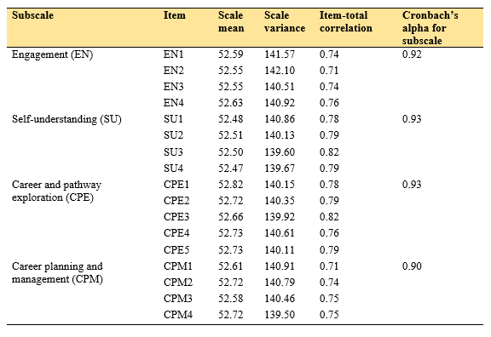
Results: Reliability Estimation (Table 2)
Table 2: Scale statistics and item-total correlations for the YCDC scale
Good reliability of all subscales and the entire YCDC scale:
The results indicated a satisfactory internal consistency
Page 10
Notes:
This page is for Slide mainly with text

Slide 11
Results: Factorial Validation in Subsamples (Table 3)
Table 3: Factorial validation in subsamples categorized by gender and years of residence in Hong Kong
Goodness of fit indexed in the CFA:
Conducted separately across subsamples categorized by gender and years of residence in Hong Kong
Page 11
Notes:
This page is for Slide mainly with text

Slide 12
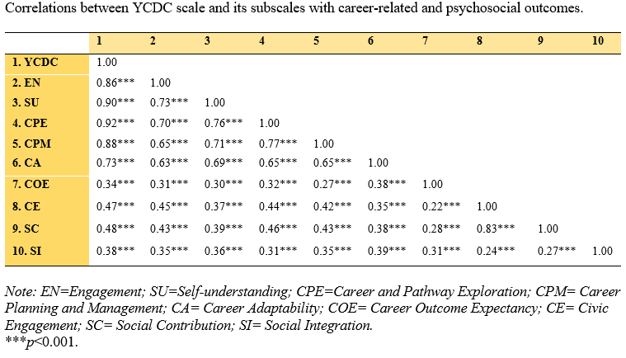
Results: Concurrent Validity (Table 4)
Table 4: Correlations between YCDC scale and its subscales with career-related and psychosocial outcomes
Good concurrent validity:
The correlation coefficients between the YCDC scale, the YCDC subscales, career adaptability, career outcome expectancy, civic engagement, social contribution, and social integration were all positive and significant
Page 12
Notes:
This page is for Slide mainly with text

Slide 13
Discussion and Conclusion
1. A rigorous instrument to measure YCDC in the Hong Kong context
Incorporate an important yet often neglected factor—engagement—to build a four-factor scale to measure YCDC in the Hong Kong context
2. Validity and Reliability of YCDC
Support the construct validity of the YCDC : All the items in each subscale significantly represented their corresponding sub-constructs
3. Sufficient fit across two respective pairs of subgroups
Support subgroup consistency and further indicate that the YCDC scale is a promising measurement tool
Respond to the call in the unique social context of Hong Kong: Provide a rigorous instrument to help young people identify their career development competency to successfully navigate transitions through education into employment
Indicate the good reliability of the YCDC scale
Align with existing literature
Demonstrate that the scale comprises adequate dimensions to assess the career development competency of young people in school-to-work transition in the Chinese context of Hong Kong
Page 13
Notes:
This page is for Slide mainly with text

Slide 14
Implications and Limitations
4. Implications
Theoretical level
Cross-context applicability of YCDC scale: Help meet the imperative need for the development of a standardized instrument for measuring young people’s career development competence in school-to-work transitions
Practical level
Policymakers, teachers, career counselors, and social workers: The YCDC scale is advisable for them to assist young people to identify their career development competency and successfully navigate the transition through education into employment
5. Limitations
Limit to the young people in the status of school-to-work transition in Hong Kong
The median was used as a cut-off point for the years of residence in Hong Kong
The cross-sectional nature of the present study: Need to verify the test-retest reliability of the scale by longitudinal data in future studies
Page 14
Notes:
This page is for Slide mainly with text

Slide 15
Acknowledgement
The study evolves from part of a larger evaluation study of the CLAP@JC Project created and funded by The Hong Kong Jockey Club Charities Trust. This conference paper is adapted from a manuscript that is under review by an international journal.
Page 15
Notes:
This page is for Slide mainly with text

Slide 16
References
Akkermans, J., Brenninkmeijer, V., Huibers, M., & Blonk, R. W. (2013). Competencies for the contemporary career: Development and preliminary validation of the Career Competencies Questionnaire. Journal of Career Development, 40(3), 245-267.
Akkermans, J., Paradniké, K., Van der Heijden, B. I., & De Vos, A. (2018). The best of both worlds: The role of career adaptability and career competencies in students’ well-being and performance. Frontiers in psychology, 9, 1678. https://doi.org/10.3389/fpsyg.2018.01678
Bakker, A. B., & Demerouti, E. (2017). Job demands–resources theory: Taking stock and looking forward. Journal of occupational health psychology, 22(3), 273-285. http://dx.doi.org/10.1037/ocp0000056
Bocciardi, F., Caputo, A., Fregonese, C., Langher, V., & Sartori, R. (2017). Career adaptability as a strategic competence for career development. European Journal of Training and Development, 41(1), 67-82. http://dx.doi.org/10.1108/EJTD-07-2016-0049
Cheung, Ch., & Liu, E. S. (2017). Enhancing the contribution of volunteering to career commitment with friendship among university students. Career Development International, 22, 754-771. http://dx.doi.org/10.1108/CDI-12-2016-0236
CLAP for Youth@JC. (2017). Report for mid-term review. Hong Kong: The Chinese University of Hong Kong & The Hong Kong Baptist University.
Coulter-Kern, R., Coulter-Kern, P., Schenkel, A., Walker, D., & Fogle, K. (2013). Improving student's understanding of career decision-making through service learning. College Student Journal, 47(2), 306-311.
DeCoster, J., Gallucci, M., & Iselin, A. M. R. (2011). Best practices for using median splits, artificial categorization, and their continuous alternatives. Journal of Experimental Psychopathology, 2(2), 197-209. http://dx.doi.org/10.5127/jep.008310
Diegelman, N. M., & Subich, L. M. (2001). Academic and vocational interests as a function of outcome expectancies in social cognitive career theory. Journal of Vocational Behavior, 59(3), 394-405. http://dx.doi.org/10.1006/jvbe.2001.1802
European Centre for the Development of Vocational Training. (2014). Navigating difficult waters: Learning for career and labour market transitions. Available online at https://www.cedefop.europa.eu/en/publications-and-resources/publications/5542
European Commission (2012). Employment and social developments in Europe 2011. Luxembourg: Publications Office of the European Union.
Huegaerts, K., Spruyt, B., & Vanroelen, C. (2018). Youth unemployment and mental health: The mediating role of embodiment. Societies, 8(2), 1-14. https://doi.org/10.3390/soc8020043
Hui, T., Yuen, M., & Chen, G. (2018). Career‐related filial piety and career adaptability in Hong Kong university students. The Career Development Quarterly, 66(4), 358-370. http://dx.doi.org/10.1002/cdq.12156
Koivisto, P., Vuori, J., & Nykyri, E. (2007). Effects of the school-to-work group method among young people. Journal of Vocational Behavior, 70, 277-296. http://dx.doi.org/10.1016/j.jvb.2006.12.001
Page 16
Notes:
This page is for Slide mainly with text

Slide 17
References
Koivisto, P., Vuori, J., & Vinokur, A. D. (2010). Transition to work: Effects of preparedness and goal construction on employment and depressive symptoms. Journal of Research on Adolescence, 20, 869-892. http://dx.doi.org/10.1111/j.1532-7795.2010.00667.x
Kuijpers, M. A. C. T., & Scheerens, J. (2006). Career competencies for the modern career. Journal of Career Development, 32, 303-319. http://dx.doi.org/10.1177/0894845305283006
Leung, S. A. (2002). Career counseling in Hong Kong: Meeting the social challenges. The Career Development Quarterly, 50(3), 237-245. http://dx.doi.org/10.1002/j.2161-0045.2002.tb00899.x
Ma, C. H. K., Chan, C. W. F., & Chan, A. C. M. (2016). The long-term impact of service-learning on graduates’ civic engagement and career exploration in Hong Kong. Journal of Higher Education Outreach and Engagement, 20(4), 37-56.
Ngai, S. S. Y., Cheung, J. C. K., To, S. M., Luan, H., & Zhao, R. (2014). Economic disadvantage and transitional outcomes: A study of young people from low-income families in Hong Kong. International journal of adolescence and youth, 19(3), 318-335.
Pallant, J. (2020). SPSS survival manual: A step by step guide to data analysis using IBM SPSS. Routledge.
Rohlfing, J. E., Nota, L., Ferrari, L., Soresi, S., & Tracey, T. J. (2012). Relation of occupational knowledge to career interests and competence perceptions in Italian children. Journal of Vocational Behavior, 81(3), 330-337. http://dx.doi.org/10.1016/j.jvb.2012.08.001
Savickas, M. L., & Porfeli, E. J. (2012). Career Adapt-Abilities Scale: Construction, reliability, and measurement equivalence across 13 countries. Journal of vocational behavior, 80(3), 661-673. http://dx.doi.org/10.1016/j.jvb.2012.01.011
Segers, J., & Inceoglu, I. (2012). Exploring supportive and developmental career management through business strategies and coaching. Human Resource Management, 51(1), 99-120. http://dx.doi.org/10.1002/hrm.20432
Siddique, C. M. (1981). Orderly careers and social integration. Industrial Relations: A Journal of Economy and Society, 20(3), 297-305.
Vuori, J., Toppinen-Tanner, S., & Mutanen, P. (2012). Effects of resource-building group intervention on career management and mental health in work organizations: randomized controlled field trial. Journal of Applied Psychology, 97(2), 273-286. http://dx.doi.org/10.1037/a0025584
Wells, K. L. H. (2018). Laboring under globalization: Tapestries by contemporary artists. Art Journal, 77(4), 26-45. http://dx.doi.org/10.1080/00043249.2018.1549874
Wong, V. (2012). Social withdrawal as invisible youth disengagement: Government inaction and NGO responses in Hong Kong. International Journal of Sociology and Social Policy, 32(7/8), 415-430. http://dx.doi.org/10.1108/01443331211249057
Zacher, H. (2014). Individual difference predictors of change in career adaptability over time. Journal of Vocational Behavior, 84(2), 188-198. http://dx.doi.org/10.1016/j.jvb.2014.01.001
Page 17
Notes:
This page is for Slide mainly with text

